Slide 1
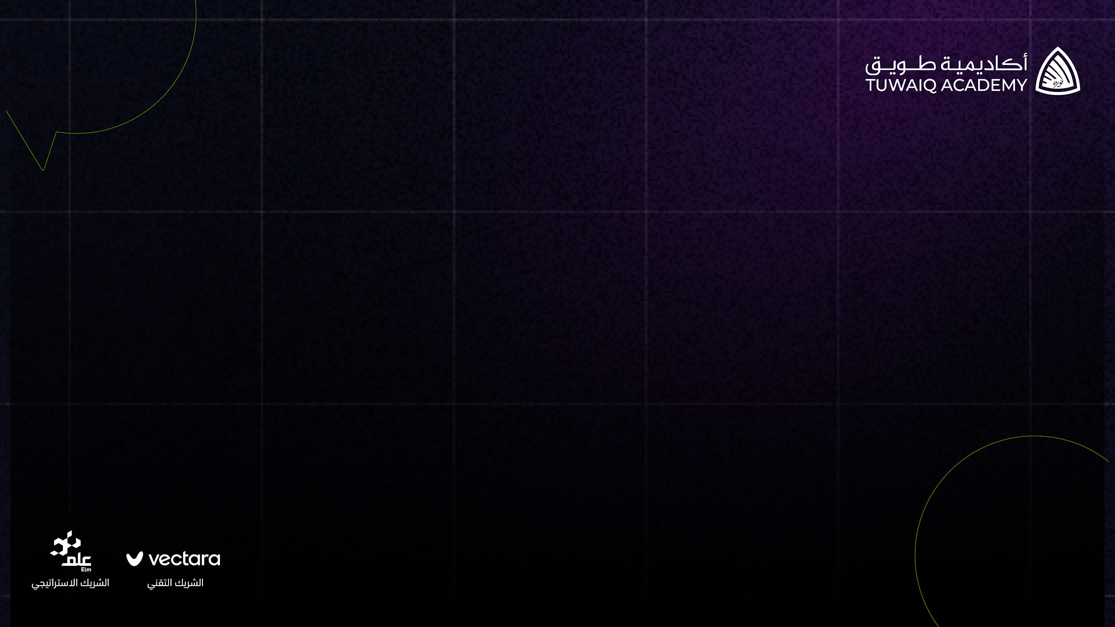

SpotGPT

Slide 2
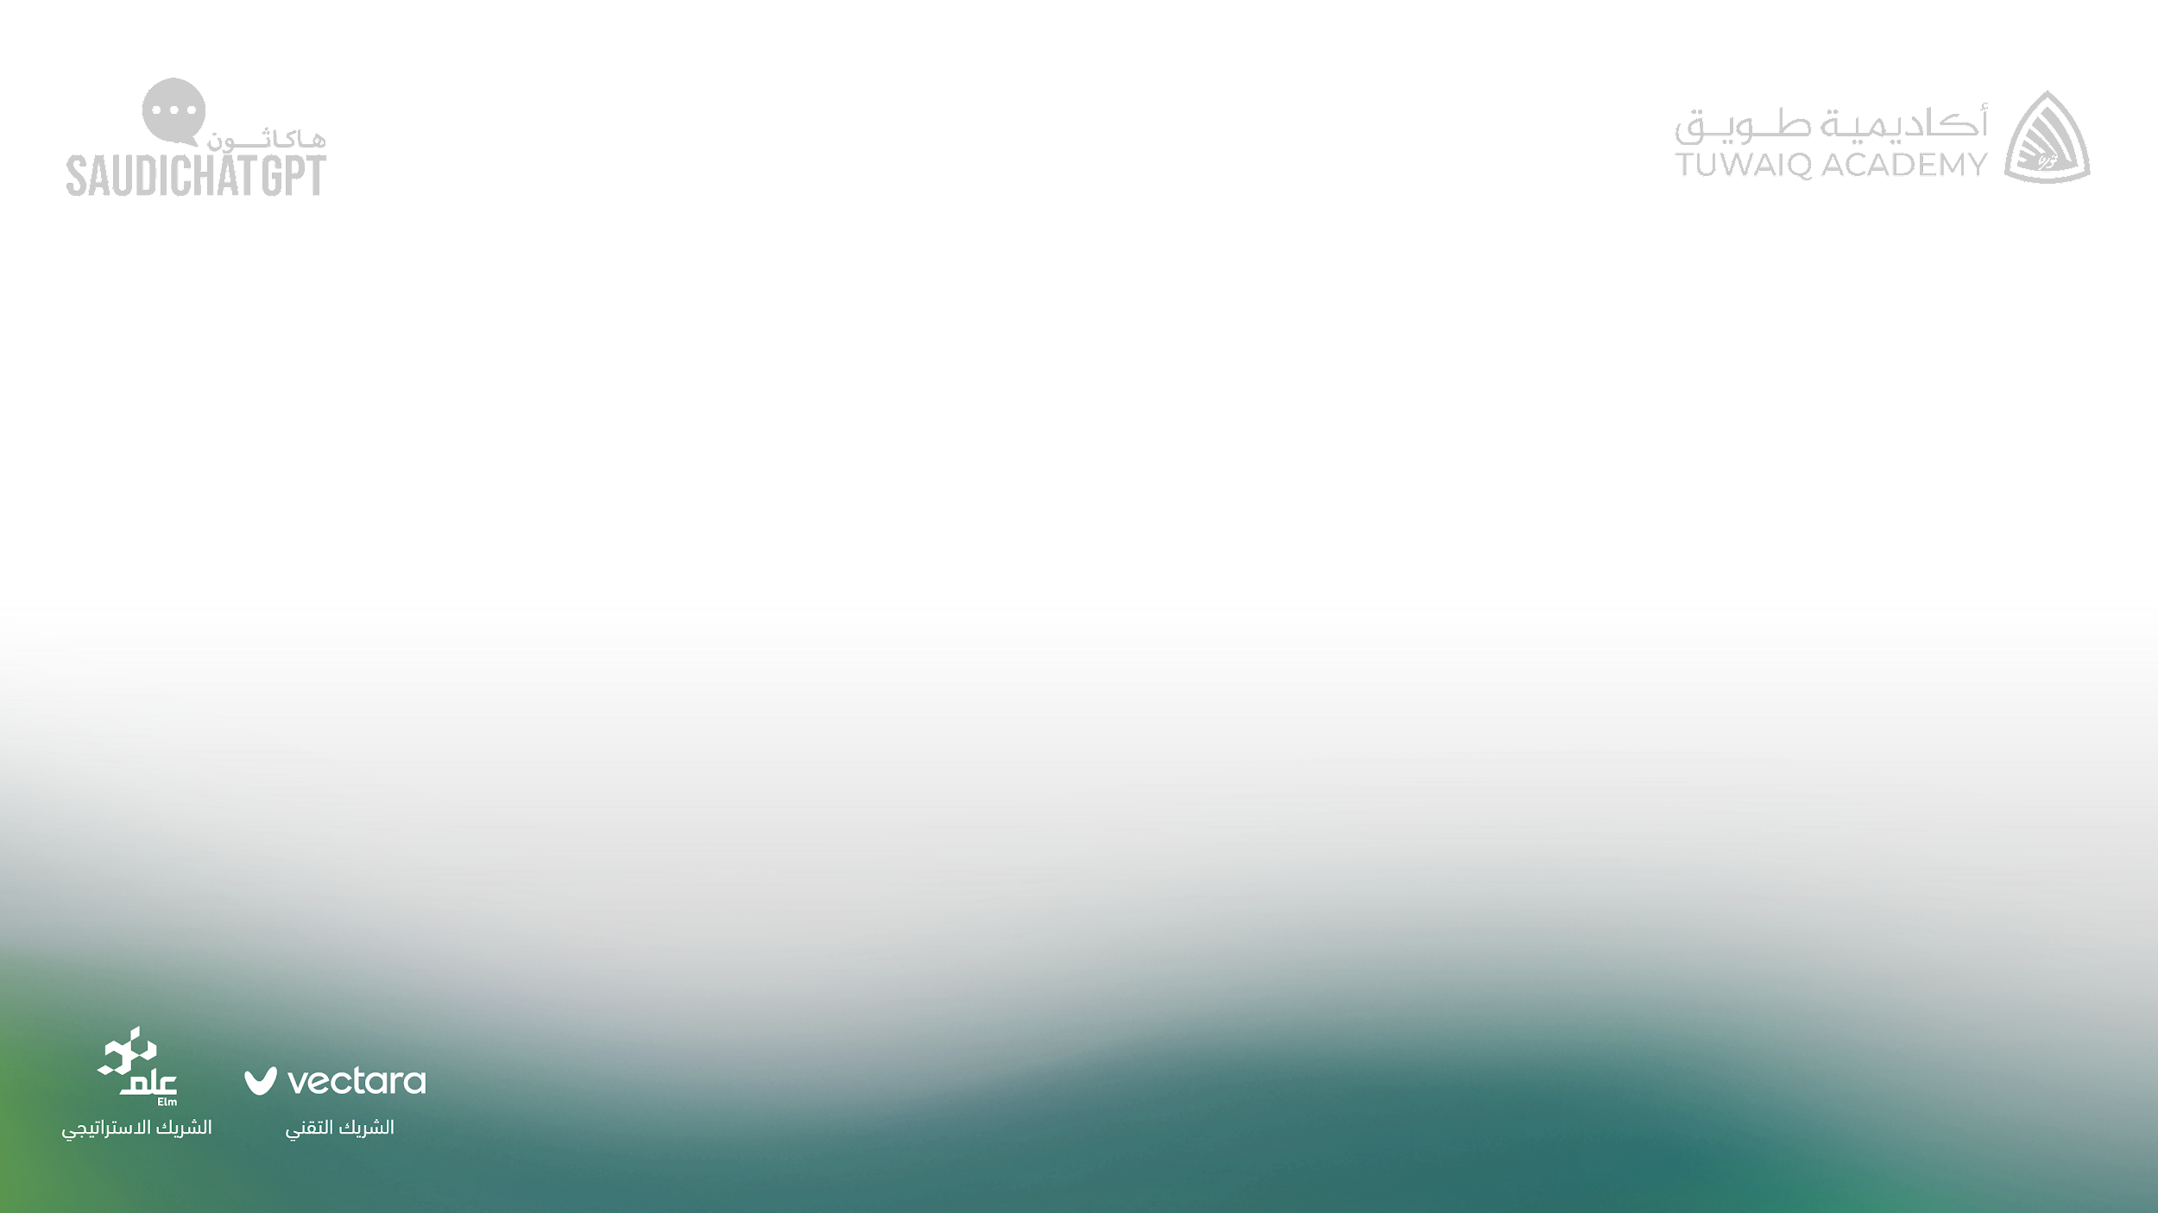
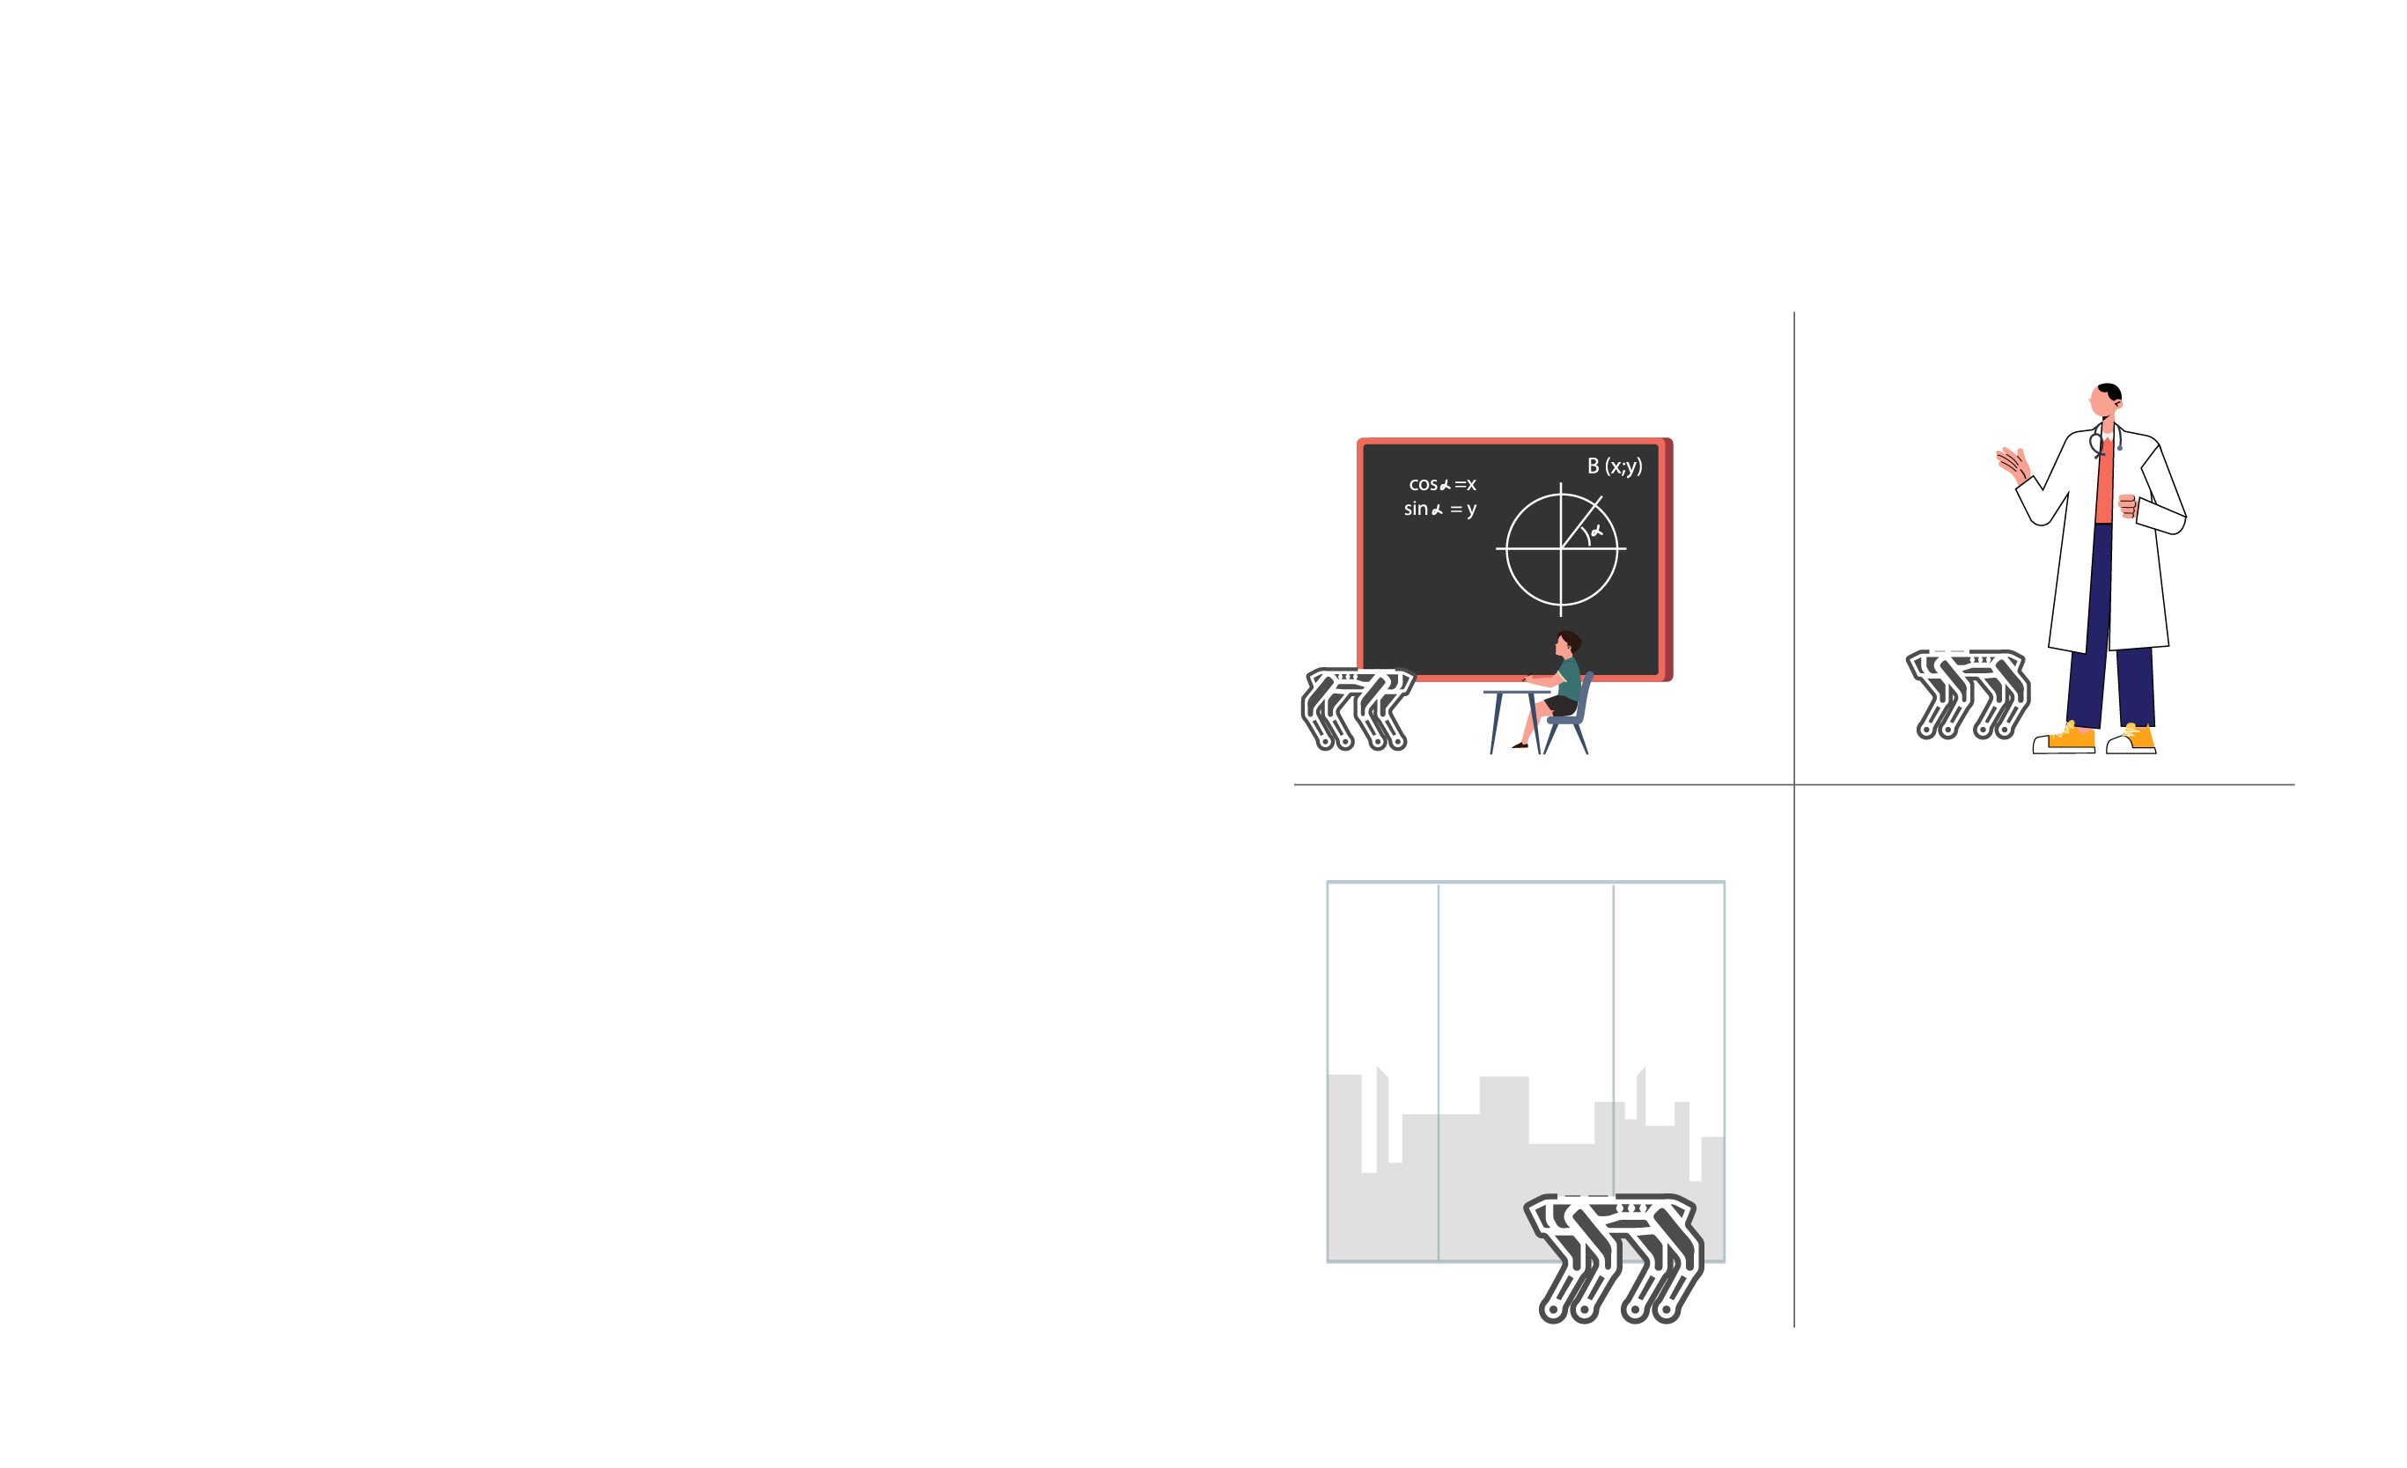
SpotGPT
SpotGPT is a highly advanced robot assistant that leverages ChatGPT’s AI capabilities to provide personalized support across a variety of fields. It is an innovative solution that can bridge the skills gap and provide expert assistance in critical areas such as education, healthcare, tourism, technology, and advisory services.
Notes:
SpotGPT is a robot assistant that uses natural language processing and machine learning to provide personalized support in fields like education, healthcare, tourism, technology, and advisory services.

Slide 3



The Problem
Saudi Arabia faces a significant skills shortage in key areas that are essential for achieving the goals of Vision 2030.
Existing robot assistants lack the natural language processing capabilities to understand complex and nuanced human interactions, limiting their effectiveness.
Notes:
Problem - Saudi Arabia faces a skills shortage, and existing robot assistants lack the natural language processing capabilities needed to understand complex human interactions.

Slide 4

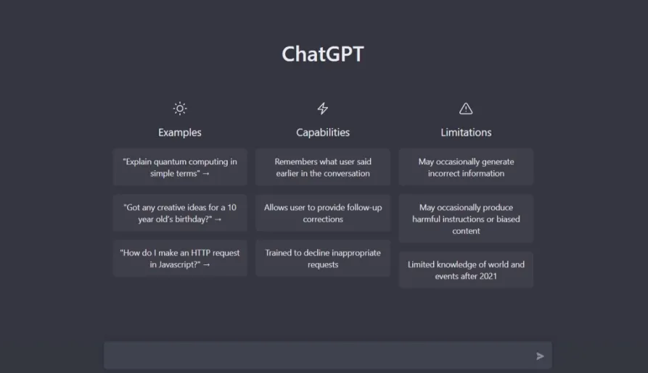
The Solution
Utilizing the ChatGPT
SpotGPT is an advanced robot assistant that uses AI and natural language processing to understand complex human interactions and provide personalized support.
It has the potential to transform critical areas such as education,healthcare, tourism, technology, and advisory services, providing expert assistance and bridging the skills gap.
Notes:
Solution - SpotGPT is an advanced robot assistant that uses AI and natural language processing to understand complex interactions and provide personalized support.

Slide 5





The Market
SpotGPT has potential applications in many fields, including but not limited to:
Advisory Services
Healthcare
Technology
Tourism
Education
And so much more….
Notes:
Market - The global robot assistant market is expected to grow to $12.7 billion by 2028, and the robotics market in Saudi Arabia is expected to grow to $4.5 billion by 2030.

Slide 6
Competitive Advantage
SpotGPT's advanced AI and natural language processing give it a significant competitive advantage over other robot assistants.
Its ability to learn and adapt to users' needs and preferences makes it a highly personalized and valuable tool.
Notes:
Competitive Advantage - SpotGPT's advanced AI and natural language processing give it a significant competitive advantage over other robot assistants.

Slide 7
Business Model
SpotGPT will be sold as a complete robot assistant package, with additional customization options available for an additional fee.
Potential revenue streams include sales, licensing, and customization services.
Notes:
Business Model - SpotGPT will be sold as a complete package, with additional customization options available for an extra fee.

Slide 8
Example
HR Robot Assistant
The robot will act as a mediator and matchmaker between job seekers and employers, facilitating the recruitment process with its advanced algorithms and data analysis capabilities.
SpotGPT can be used as an HR robot assistant, providing personalized support and automating tasks such as recruitment, onboarding, and employee engagement.
It can also be used as an advisor for career development and skills training, helping employees to bridge skills gaps and achieve their career goals.
Notes:
: Example: HR Robot Assistant - SpotGPT can be used as an HR robot assistant, providing personalized support and automating tasks like recruitment and onboarding.

Slide 9
Conclusion
SpotGPT is a versatile and innovative robot assistant that has the potential to transform critical areas such as education, healthcare, tourism, technology, and advisory services.
With its advanced AI capabilities and potential for customization, SpotGPT is well-positioned to become a leader in the emerging robot assistant market, and contribute significantly to the goals of Saudi Vision 2030. .
Notes:
Conclusion - SpotGPT is a versatile robot assistant with advanced AI capabilities, well-positioned to become a leader in the emerging market and contribute to the goals of Saudi Vision 2030.

Slide 10
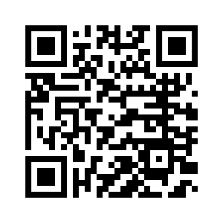
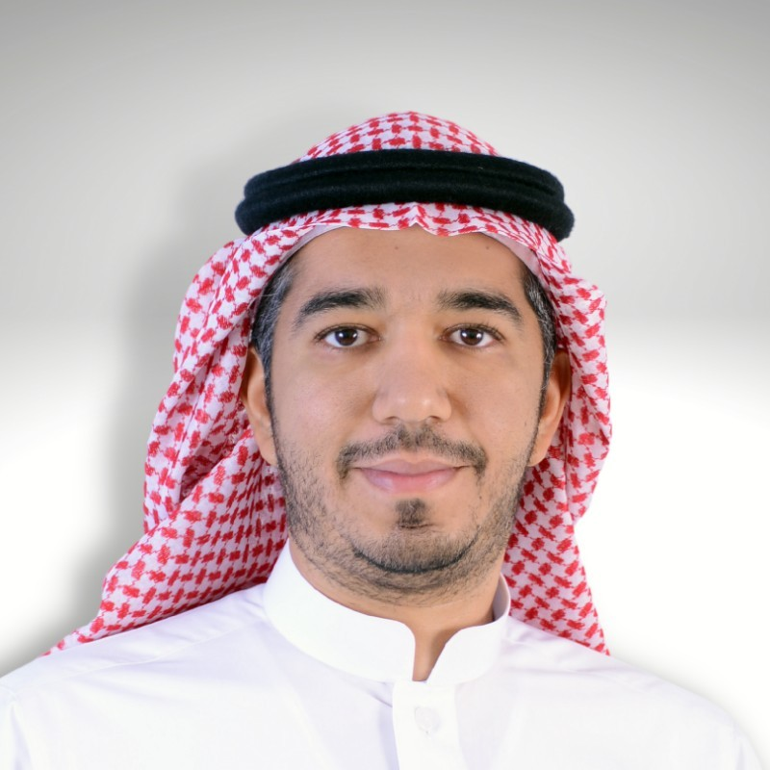
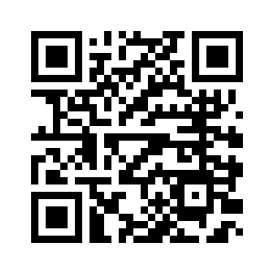
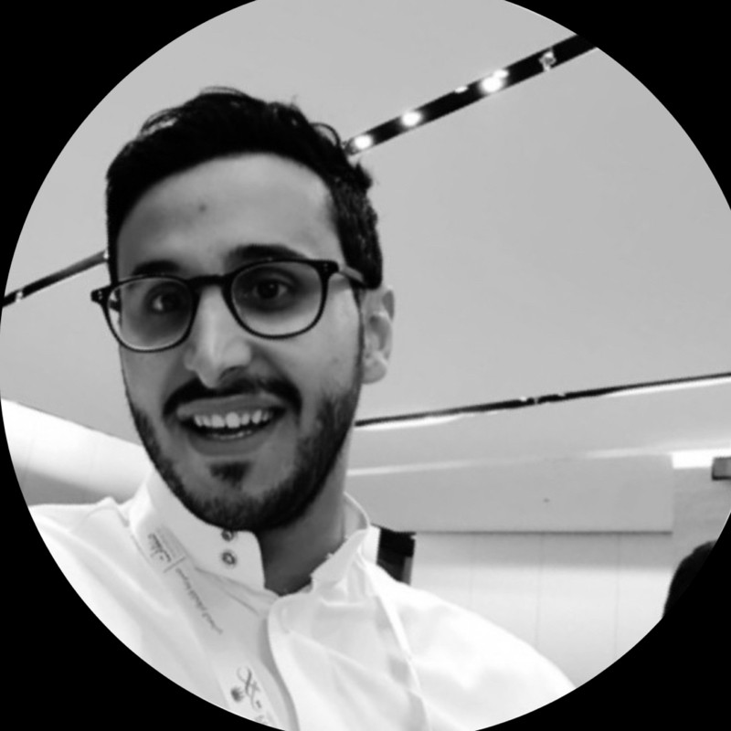
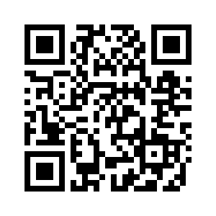

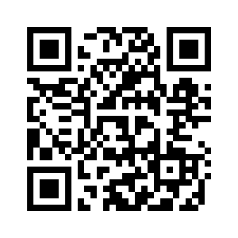
The Team
Our team consists of experienced roboticists and AI engineers who are passionate about creating innovative and user-friendly robot assistants.
Yasir Iskobi
Faisal Alotaibi
Ahmed Aljaser
Lina Bin Khathlan

